Slide 1
Chapter 1: Introduction to the Personal Computer
BIT1205 YEAR 1 SEM2
Introduction: PC Hardware and Software
Notes:
Cisco Networking Academy program
IT Essentials: PC Hardware and Software v4.0
Chapter 1: Introduction to the Personal Computer

Slide 2
Chapter 1 Objectives
1.2 Describe a computer system
1.3 Identify the names, purposes, and characteristics of cases and power supplies
1.4 Identify the names, purposes, and characteristics of internal components
1.5 Identify the names, purposes, and characteristics of ports and cables
1.6 Identify the names, purposes, and characteristics of input devices
1.7 Identify the names, purposes, and characteristics of output devices
1.8 Explain system resources and their purposes
Notes:
Slide 3 – Chapter 1 Objectives
Upon completion of this chapter, students will be able to perform tasks related to:
1.1 Explain the IT industry certification
1.2 Describe a computer system
1.3 Identify the names, purposes, and characteristics of cases and power supplies
1.4 Identify the names, purposes, and characteristics of internal components
1.5 Identify the names, purposes, and characteristics of ports and cables
1.6 Identify the names, purposes, and characteristics of input devices
1.7 Identify the names, purposes, and characteristics of output devices
1.8 Explain system resources and their purposes

Slide 3
Information Technology (IT)
The design, development, implementation, support, and management of computer hardware, software and communication applications.
An IT professional is knowledgeable about computer systems and operating systems.
Notes:
Slide 5 – Information Technology (IT)
1.0 Chapter Introduction
Information technology (IT) is the design, development, implementation, support, and management of computer hardware and software applications. An IT professional is knowledgeable about computer systems and operating systems. This chapter will review IT certifications and the components of a basic personal computer system.
After completing this chapter, students will meet these objectives:
Explain the IT industry certification
Describe a computer system
Identify the names, purposes, and characteristics of cases and power supplies
Identify the names, purposes, and characteristics of internal components
Identify the names, purposes, and characteristics of ports and cables
Identify the names, purposes, and characteristics of input devices
Identify the names, purposes, and characteristics of output devices
Explain system resources and their purposes

Slide 4
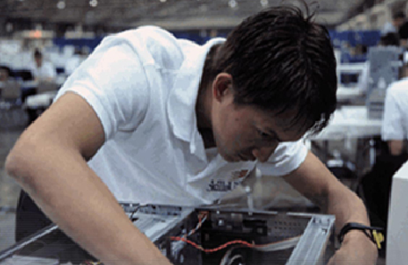
IT Technician
An IT technician provides computer or network support to customers or employees. ...
IT technicians troubleshoot technical issues and provide help desk support to users.
A computer technician is an individual who identifies, troubleshoots and resolves computer problems.
Computers include desktop, laptop, and personal electronic devices
Has specialized skills to install, maintain, and repair computers
Notes:
Slide 6 – IT Technician
1.1 Explain the IT industry and your place in it
This course will focus on desktop and laptop computers. It will also discuss electronic devices, such as personal digital assistants and cell phones. Training and experience will qualify a technician to service these computers and personal electronic devices. Students will gain the specialized technical skills needed to install, maintain, and repair computers.
Earning an industry standard certification can improve confidence and can increase job opportunities in IT. This course is focused on the following two industry standard certifications:
The CompTIA A+
The European Certification of Informatics Professional (EUCIP) IT Administrator Certification (Modules 1- 3)
After completing this section, students will meet these objectives:
Identify the education and certifications required
Describe the A+ Certification
Describe the EUCIP Certification
Identify advanced careers

Slide 5
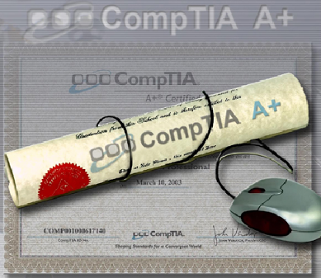
Education and Certification
A successful IT technician has training and experience in the following:
  Personal computers, printers,
  scanners, and laptop computers
  Safe lab procedures
  Troubleshooting
  Operating systems
  Networks
  Security
  Communication skills
Notes:
Slide 7 – Education and Certification
1.1.1 Identify education and certifications
This course covers the information that a technician needs to be successful in IT:
Personal computers
Safe lab procedures
Troubleshooting
Operating systems
Laptop computers
Printers and scanners
Networks
Security
Communication skills
This course focuses on two hardware and software skills-based industry certifications: CompTIA A+ and EUCIP. This course is only an introduction into the world of IT. A technician may continue to study and earn the following certifications:
CCNA - Cisco Certified Networking Associate
CCNP - Cisco Certified Networking Professional
CCIE - Cisco Certified Internetworking Expert
CISSP - Certified Information Systems Security Professional
MCP - Microsoft Certified Professional
MCSA - Microsoft Certified Systems Administrator
MCSE - Microsoft Certified Systems Engineer
Network+ - CompTIA Network Certification
Linux+ - CompTIA Linux Certification
IT certifications can be used as credits for university and college degrees in areas such as computer science and telecommunications.

Slide 6
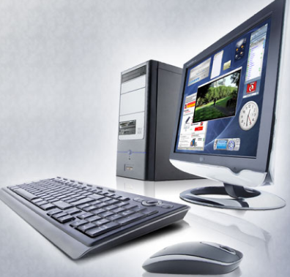
Basic Personal Computer System
A computer system consists of hardware, software and users components.
Hardware is the physical equipment such as the case, storage drives, keyboards, monitors, cables, speakers, and printers.
Software is the operating
system and programs.
The operating system
instructs the computer how
to operate.
Programs or applications
perform different functions.
Notes:
Slide 11 – PCs and Customer Needs
1.2 Describe a computer system
A computer system consists of hardware and software components. Hardware is the physical equipment such as the case, storage drives, keyboards, monitors, cables, speakers, and printers. The term software includes the operating system and programs. The operating system instructs the computer how to operate. These operations may include identifying, accessing, and processing information. Programs or applications perform different functions. Programs vary widely depending on the type of information that will be accessed or generated. For example, instructions for balancing a checkbook are very different from instructions for simulating a virtual reality world on the Internet.
The following sections in this chapter discuss the hardware components found in a computer system.

Slide 7
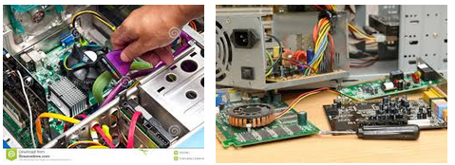

Slide 8
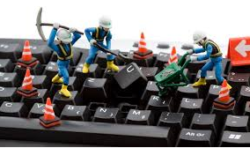

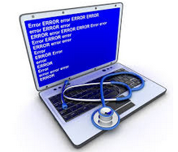
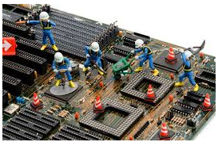

Slide 9
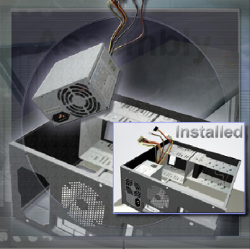
Computer Cases and Power Supplies
Computer case
Provides protection and support for internal components
Should be durable, easy to service, and have enough room for expansion
Power supply
Converts AC power from the
wall socket into DC
Must provide enough power
for the installed components
and future additions
Notes:
Slide 12 – Computer Cases and Power Supplies
1.3 Identify the names, purposes, and characteristics of cases and power supplies
Computer case
Provides protection and support for the internal components of the computer.
Should be durable, easy to service, and have enough room for expansion
The size and shape of the computer case is usually determined by the motherboard and other internal components.
Power supply
Converts alternating-current (AC) power from the wall socket into direct-current (DC) power
The power supply must provide enough power for the components that are currently installed and allow for additional components that may be added at a later time. If you choose a power supply that powers only the current components, it may be necessary to replace the power supply when other components are upgraded.
After completing this section, students will meet these objectives:
Describe cases
Describe power supplies

Slide 10
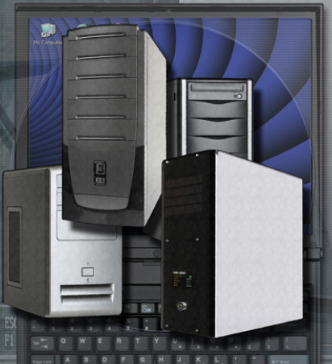
Computer Cases
Contain the framework to support and enclose internal components of the computer
Typically made of plastic, steel, and aluminum
Available in a variety of styles
The size and layout of a case is called a form factor
Designed to keep internal components cool
Helps to prevent damage from static electricity
Notes:
Slide 13 – Computer Cases
1.3.1 Describe cases
A computer case contains the framework to support the internal components of a computer while providing an enclosure for added protection. Computer cases are typically made of plastic, steel, and aluminum and are available in a variety of styles.
The size and layout of a case is called a form factor. There are many types of cases, but the basic form factors for computer cases include desktop and tower. Desktop cases may be slimline or full-sized, and tower cases may be mini or full-sized.
Computer cases are referred to in a number of ways:
Computer chassis
Cabinet
Tower
Box
Housing
In addition to providing protection and support, cases also provide an environment designed to keep the internal components cool. Case fans are used to move air through the computer case. As the air passes warm components, it absorbs heat and then exits the case. This process keeps the components of the computer from overheating.

Slide 11
Case Selection
Factor | Rationale
Model Type | Two main case models (one for desktop PCs and the other for tower PCs). The type of motherboard determines the type of case. Size and shape must match exactly.
Size | If a computer has many components, it will need more room for airflow to keep the system cool.
Available Space | Desktop cases allow space conservation in tight areas because the monitor can be placed on top of the unit. The case design may limit the number and size of the components that can be added.
Power Supply | Match the power rating and connection type of the power supply to the type of motherboard chosen.
Appearance | There are many case designs to choose from if it is necessary to have a case that is attractive.
Status Display | LED indicators that are mounted on the front of the case can tell you if the system is receiving power, when the hard drive is being used, and when the computer is on standby or sleeping.
Vents | All cases have a vent on the power supply. Some cases have more vents to dissipate an unusual amount of heat.
Notes:
Slide 14 – Case Selection
1.3.1 Describe cases
There are many factors that must be considered when choosing a case:
The size of the motherboard
The number of external or internal drive locations called bays
Available space
In addition to providing protection from the environment, cases help to prevent damage from static electricity. Internal components of the computer are grounded by attachment to the case.
NOTE: You should select a case that matches the physical dimensions of the power supply and motherboard.

Slide 12
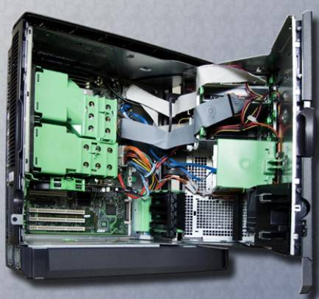
Internal Components
Notes:
Slide 18 – Internal Components
1.4 Identify the names, purposes, and characteristics of internal components
This section discusses the names, purposes, and characteristics of the internal components of a computer. After completing this section, you will meet these objectives:
Identify the names, purposes, and characteristics of motherboards
Explain the names, purposes, and characteristics of CPUs
Identify the names, purposes, and characteristics of cooling systems
Identify the names, purposes, and characteristics of ROM and RAM
Identify the names, purposes, and characteristics of adapter cards
Identify the names, purposes, and characteristics of storage drives
Identify the names, purposes, and characteristics of internal cables

Slide 13
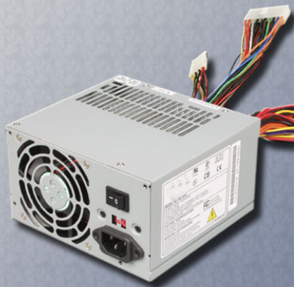
Power Supplies
The power supply converts alternating-current (AC) power coming from a wall outlet into direct-current (DC) power, which is a lower voltage.
DC power is required for all of the components inside the computer.
Cables, connectors, and
components are designed
to fit together snugly.
Never force any connector
or component.
Notes:
Slide 15 – Power Supplies
1.3.2 Describe power supplies
The power supply converts alternating-current (AC) power coming from a wall outlet into direct-current (DC) power, which is a lower voltage. DC power is required for all of the components inside the computer.
Most connectors today are keyed connectors. Keyed connectors are designed to be inserted in only one direction. Each part of the connector has a colored wire with a different voltage running through it. Different connectors are used to connect specific components and various locations on the motherboard:
Molex connector is a keyed connector used to connect to an optical drive or a hard drive.
Berg connector is a keyed connector used to connect to a floppy drive. A Berg connector is smaller than a Molex connector.
A 20-pin or 24-pin slotted connector is used to connect to the motherboard. The 24-pin slotted connector has two rows of 12-pins each, and the 20-pin slotted connector has two rows of 10-pins each.
A 4-pin to 8-pin auxiliary power connector has two rows of two to four pins and supplies power to all areas of the motherboard. The 4-pin to 8-pin auxiliary power connector is the same shape as the main power connector, but smaller.
Older standard power supplies used two connectors called P8 and P9 to connect to the motherboard. P8 and P9 were unkeyed connectors. They could be installed backwards, potentially damaging the motherboard or power supply. The installation required that the connectors were lined up with the black wires together in the middle.
NOTE: If you have a difficult time inserting a connector, try a different way, or check to make sure there are no bent pins or foreign objects in the way. Remember, if it seems difficult to plug in any cable or other part, there is something wrong. Cables, connectors, and components are designed to fit together snugly. Never force any connector or component. Take your time and make sure that you are handling the hardware correctly.

Slide 14
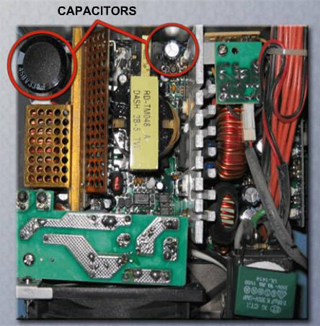
Power Supplies
CAUTION: Do not open a power supply.
Electronic capacitors located inside of a power supply can hold a charge for extended periods of time.
Notes:
Slide 17 – Power Supplies
1.3.2 Describe power supplies
CAUTION: Do not open a power supply. Electronic capacitors located inside of a power supply can hold a charge for extended periods of time.

Slide 15
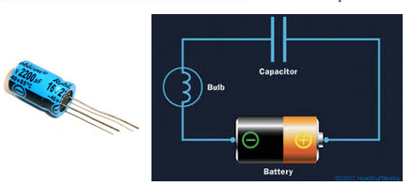
A capacitor
A capacitor is a passive two-terminal electrical component that stores electrical energy in an electric field
A capacitor works like a tiny rechargeable battery with very very very low capacity.
The capacitor can store charge. And it can release the charge when needed.

Slide 16
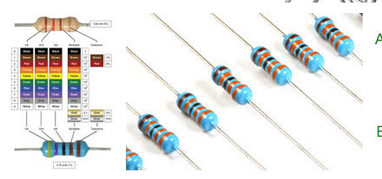
A resistor
A resistor is a passive two-terminal electrical component that implements electrical resistance as a circuit element. In electronic circuits, resistors are used to reduce current flow, adjust signal levels, to divide voltages,

Slide 17
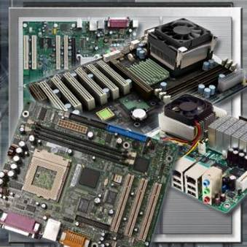
Motherboards
The main printed circuit board.
Contains the buses, or electrical
pathways found in a computer.
Buses allow data to travel
among the various components.
Also known as the system board,
the backplane, or the main board.
Accommodates CPU, RAM, expansion slots, heat sink/fan assembly, BIOS chip, chip set, sockets, internal and external connectors, various ports, and the embedded wires that interconnect the motherboard components.
Notes:
Slide 19 – Motherboards
1.4.1 Identify the names, purposes, and characteristics of motherboards
The motherboard is the main printed circuit board and contains the buses, or electrical pathways, found in a computer. These buses allow data to travel between the various components that comprise a computer. A motherboard is also known as the system board, the backplane, or the main board.
The motherboard accommodates the central processing unit (CPU), RAM, expansion slots, heat sink/fan assembly, BIOS chip, chip set, and the embedded wires that interconnect the motherboard components. Sockets, internal and external connectors, and various ports are also placed on the motherboard.

Slide 18
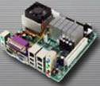
Motherboard Form Factors
The form factor of motherboards pertains to the size and shape of the board.
It also describes the physical layout of the different components and devices on the motherboard.
Various form factors exist for motherboards.
  AT – Advanced Technology
  ATX – Advanced Technology Extended
  Mini-ATX – Smaller footprint of ATX
  Micro-ATX – Smaller footprint of ATX
  LPX – Low-profile Extended
  NLX – New Low-profile Extended
  BTX – Balanced Technology Extended
Notes:
Slide 20 – Motherboards
1.4.1 Identify the names, purposes, and characteristics of motherboards
The form factor of motherboards pertains to the size and shape of the board. It also describes the physical layout of the different components and devices on the motherboard. Various form factors exist for motherboards.
An important set of components on the motherboard is the chip set. The chip set is composed of various integrated circuits attached to the motherboard that control how system hardware interacts with the CPU and motherboard. The CPU is installed into a slot or socket on the motherboard. The socket on the motherboard determines the type of CPU that can be installed.
The chip set of a motherboard allows the CPU to communicate and interact with the other components of the computer, and to exchange data with system memory, or RAM, hard disk drives, video cards, and other output devices. The chip set establishes how much memory can be added to a motherboard. The chip set also determines the type of connectors on the motherboard.
Most chip sets are divided into two distinct components, Northbridge and Southbridge. What each component does varies from manufacturer to manufacturer, but in general the Northbridge controls access to the RAM, video card, and the speeds at which the CPU can communicate with them. The video card is sometimes integrated into the Northbridge. The Southbridge, in most cases, allows the CPU to communicate with the hard drives, sound card, USB ports, and other I/O ports.

Slide 19
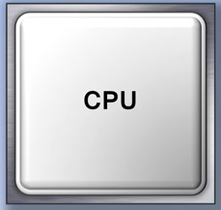
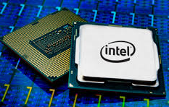
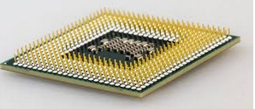
Central Processing Unit (CPU)
Known as the brain of the computer. Also
referred to as the processor.
Most important element of a computer system. Executes a program, which is a sequence of stored instructions.
Notes:
Slide 21 – Central Processing Unit (CPU)
1.4.2 Identify the names, purposes, and characteristics of CPUs
The central processing unit (CPU) is considered the brain of the computer. It is sometimes referred to as the processor. Most calculations take place in the CPU. In terms of computing power, the CPU is the most important element of a computer system. CPUs come in different form factors, each style requiring a particular slot or socket on the motherboard. Common CPU manufacturers include Intel and AMD.
The CPU socket or slot is the connector that interfaces between the motherboard and the processor itself. Most CPU sockets and processors in use today are built around the pin grid array (PGA) architecture, in which the pins on the underside of the processor are inserted into the socket, usually with zero insertion force (ZIF). ZIF refers to the amount of force needed to install a CPU into the motherboard socket or slot. Slot-based processors are cartridge-shaped and fit into a slot that looks similar to an expansion slot.
The CPU executes a program, which is a sequence of stored instructions. Each model of processor has an instruction set, which it executes. The CPU executes the program by processing each piece of data as directed by the program and the instruction set. While the CPU is executing one step of the program, the remaining instructions and the data are stored nearby in a special memory called cache. There are two major CPU architectures related to instruction sets:
Reduced Instruction Set Computer (RISC) – Architectures use a relatively small set of instructions, and RISC chips are designed to execute these instructions very rapidly.
Complex Instruction Set Computer (CISC) – Architectures use a broad set of instructions, resulting in fewer steps per operation.

Slide 20
Modern CPUs are designed with multiple cores, allowing them to execute multiple tasks simultaneously
Different manufacturers create CPUs, with some of the most well-known being Intel and AMD.
The performance of a CPU is influenced by factors like clock speed, number of cores, architecture, and manufacturing process
Intel and AMD are two of the most prominent manufacturers of CPUs (Central Processing Units) for personal computers and servers

Slide 21
Intel Corporation is one of the oldest and most well-known CPU manufacturers. They have produced a variety of processors for desktops, laptops, and servers
Intel's processor generations in clude names like Core i3, Core i5, Core i7, and Core i9 for desktops and laptops.
AMD CPU
Advanced Micro Devices (AMD) is another major player in the CPU market. They have gained significant popularity with their Ryzen series processors
Ryzen processors are categorized into Ryzen 3, Ryzen 5, Ryzen 7, and Ryzen 9, with higher numbers denoting higher performance tiers.

Slide 22
Read about
strengths and weaknesses of Intel and AMD

Slide 23
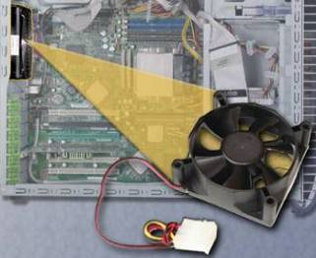
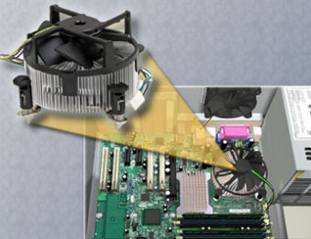
Cooling Systems
Electronic components generate heat. Too much heat can damage components.
A case fan makes the cooling process more efficient.
A heat sink draws heat away from the core of the CPU. A fan on top of the heat sink moves the heat away from the CPU.
Fans are dedicated to cool the Graphics-processing unit (GPU).
Case Fan
CPU Fan
Notes:
Slide 23 – Cooling Systems
1.4.3 Identify the names, purposes, and characteristics of cooling systems
Electronic components generate heat. Heat is caused by the flow of current within the components. Computer components perform better when kept cool. If the heat is not removed, the computer may run slower. If too much heat builds up, computer components can be damaged.
Increasing the air flow in the computer case allows more heat to be removed. A case fan is installed in the computer case to make the cooling process more efficient.
In addition to case fans, a heat sink draws heat away from the core of the CPU. A fan on top of the heat sink moves the heat away from the CPU.
Other components are also susceptible to heat damage and are sometimes equipped with fans. Video adapter cards also produce a great deal of heat. Fans are dedicated to cool the graphics-processing unit (GPU).
Computers with extremely fast CPUs and GPUs may use a water-cooling system. A metal plate is placed over the processor and water is pumped over the top to collect the heat that the CPU creates. The water is pumped to a radiator to be cooled by the air, and then re-circulated.

Slide 24
Read-only Memory (ROM)
Basic instructions for booting the computer and loading the operating system are stored in ROM.
ROM Types | ROM Types | Description
ROM | Read-only memory chips | Information is written to a ROM chip when it is manufactured. A ROM chip cannot be erased or re-written and can become obsolete.
PROM | Programmable read-only memory | Information is written to a PROM chip after it is manufactured. A PROM chip cannot be erased or re-written.
EPROM | Erasable programmable read-only memory | Information is written to an EPROM chip after it is manufactured. An EPROM chip can be erased with exposure to UV light. Special equipment is required.
EEPROM | Electrically erasable programmable read-only memory | Information is written to an EEPROM chip after it is manufactured. EEPROM chips are also called Flash ROMs. An EEPROM chip can be erased and re-written without having to remove the chip from the computer.
Notes:
Slide 24 – Read-only Memory (ROM)
1.4.4 Identify the names, purposes, and characteristics of ROM and RAM
Read-only memory (ROM) chips are located on the motherboard. ROM chips contain instructions that can be directly accessed by the CPU. Basic instructions for booting the computer and loading the operating system are stored in ROM. ROM chips retain their contents even when the computer is powered down. The contents cannot be erased or changed by normal means.
NOTE: ROM is sometimes called firmware. This is misleading because firmware is actually the software that is stored in a ROM chip.

Slide 25
Random-access Memory (RAM)
Temporary storage for data and programs that are being accessed by the CPU
Volatile memory, which means that the contents are erased when the computer is powered off
More RAM means more capacity to hold and process large programs and files, as well as enhance system performance.
Types of RAM:
  Dynamic Random Access Memory (DRAM)
  Static Random Access Memory (SRAM)
  Fast Page Mode DRAM (FPM Memory)
  Extended Data Out RAM (EDO Memory)
  Synchronous DRAM (SDRAM)
  Double Data Rate SDRAM (DDR SDRAM)
  Double Data Rate 2 SDRAM (DDR2 SDRAM)
  RAMBus DRAM (RDRAM)
Notes:
Slide 25 – Random-access Memory (RAM)
1.4.4 Identify the names, purposes, and characteristics of ROM and RAM
Random access memory (RAM) is the temporary storage for data and programs that are being accessed by the CPU. RAM is volatile memory, which means that the contents are erased when the computer is powered off. The more RAM in a computer, the more capacity the computer has to hold and process large programs and files, as well as enhance system performance. The different types of RAM are:
Dynamic Random Access Memory (DRAM) is a memory chip that is used as main memory. DRAM must be constantly refreshed with pulses of electricity in order to maintain the data stored within a chip.
Static Random Access Memory (SRAM) is a memory chip that is used as cache memory. SRAM is much faster than DRAM and does not have to be refreshed as often.
Fast Page Mode DRAM (FPM Memory) is memory that supports paging. Paging enables faster access to the data than regular DRAM. Most 486 and Pentium systems from 1995 and earlier use FPM memory.
Extended Data Out RAM (EDO Memory) is memory that overlaps consecutive data accesses. This speeds up the access time to retrieve data from memory, because the CPU does not have to wait fro one data access cycle to end before another data access cycle begins.
Synchronous DRAM (SDRAM) is DRAM that operates in synchronization with the memory bus. The memory bus is the data path between the CPU and the main memory.
Double Data Rate SDRAM (DDR SDRAM) is memory that transfers data twice as fast a SDRAM. DDR SDRAM increases performance by transferring data twice per cycle.
Double Data Rate 2 SDRAM (DDR2 SDRAM) is faster than DDR SDRAM memory. DDR2 SDRAM improves performance over DDR SDRAM by decreasing noise and crosstalk between the signal wires.
RAMBus DRAM (RDRAM) is a memory chip that was developed to communicate at very high rates of speed. RDRAM chips are not commonly used.

Slide 26
Memory Modules
Dual Inline Package (DIP) is an individual memory chip. A DIP had dual rows of pins used to attach it to the motherboard.
Single Inline Memory Module (SIMM) is a small circuit board that holds several memory chips. SIMMs have 30-pin and 72-pin configurations.
Dual Inline Memory Module (DIMM) is a circuit board that holds SDRAM, DDR SDRAM, and DDR2 SDRAM chips. There are 168-pin SDRAM DIMMs, 184-pin DDR DIMMs, and 240-pin DDR2 DIMMs.
RAM Bus Inline Memory Module (RIMM) is a circuit board that holds RDRAM chips. A typical RIMM has a 184-pin configuration.
Notes:
Slide 26 – Memory Modules
1.4.4 Identify the names, purposes, and characteristics of ROM and RAM
Early computers had RAM installed on the motherboard as individual chips. The individual memory chips, called dual inline package (DIP) chips, were difficult to install and often became loose on the motherboard. To solve this problem, designers soldered the memory chips on a special circuit board called a memory module. The different types of memory modules are:
Dual Inline Package (DIP) is an individual memory chip. A DIP had dual rows of pins used to attach it to the motherboard.
Single Inline Memory Module (SIMM) is a small circuit board that holds several memory chips. SIMMs have 30-pin and 72-pin configurations.
Dual Inline Memory Module (DIMM) is a circuit board that holds SDRAM, DDR SDRAM, and DDR2 SDRAM chips. There are 168-pin SDRAM DIMMs, 184-pin DDR DIMMs, and 240-pin DDR2 DIMMs.
RAM Bus Inline Memory Module (RIMM) is a circuit board that holds RDRAM chips. A typical RIMM has a 184-pin configuration.
NOTE: Memory modules can be single-sided or double-sided. Single-sided memory modules only contain RAM on one side of the module. Double-sided memory modules contain RAM on both sides of the module.

Slide 27
Cache and Error Checking
Cache
SRAM is used as cache memory to store the most frequently used data.
SRAM provides the processor with faster access to the data than retrieving it from the slower DRAM, or main memory.
Error Checking
Memory errors occur when the data is not stored correctly in the RAM chips.
The computer uses different methods to detect and correct data errors in memory.
Notes:
Slide 27 – Cache and Error Checking
1.4.4 Identify the names, purposes, and characteristics of ROM and RAM
Cache - SRAM is used as cache memory to store the most frequently used data. SRAM provides the processor with faster access to the data than retrieving it from the slower DRAM, or main memory. The three types of cache memory are:
L1 cache is internal cache and is integrated into the CPU.
L2 cache is external cache and was originally mounted on the motherboard near the CPU. L2 cache is now integrated into the CPU.
L3 cache is used on some high-end workstations and server CPUs.
Error Checking - Memory errors occur when the data is not stored correctly in the RAM chips. The computer uses different methods to detect and correct data errors in memory. Three different methods of memory error checking are:
Nonparity memory does not check for errors in memory.
Parity memory contains eight bits for data and one bit for error checking. The error-checking bit is called the parity bit.
Error Correction Code (ECC) memory can detect multiple bit errors in memory and correct single bit errors in memory.
is a hardware or software component that stores data so that future requests for that data can be served faster; the data stored in a cache might be the result of an earlier computation or a copy of data stored elsewhere

Slide 28
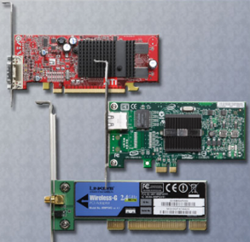
Adapter Cards
Increase the functionality of a computer by adding controllers for specific devices or by replacing malfunctioning ports.
Examples of adapter cards:
  Sound adapter and video adapter
  USB, parallel, and serial ports
  RAID adapter and SCSI adapter
  Network Interface Card (NIC),
  wireless NIC, and modem adapter
Types of expansion slots:
  Industry Standard Architecture (ISA)
  Extended Industry Standard Architecture (EISA)
  Microchannel Architecture (MCA)
  Peripheral Component Interconnect (PCI)
  Advanced Graphics Port (AGP)
  PCI-Express
Notes:
Slide 28 – Adapter Cards
1.4.5 Identify the names, purposes, and characteristics of adapter cards
Adapter cards increase the functionality of a computer by adding controllers for specific devices or by replacing malfunctioning ports. Adapter cards are used to expand and customize the capability of the computer:
NIC - Connects computer to a network using a network cable
Wireless NIC - Connects computer to a network using radio frequencies
Sound adapter - Provides audio capability
Video adapter - Provides graphic capability
Modem adapter - Connects a computer to the Internet using a phone line
SCSI adapter - Connects SCSI devices, such as hard drives or tape drives, to a computer
RAID adapter - Connects multiple hard drives to a computer to provide redundancy and improve performance
USB port - Connects a computer to peripheral devices
Parallel port - Connects a computer to peripheral devices
Serial port - Connects a computer to peripheral devices
Computers have expansion slots on the motherboard to install adapter cards. The type of adapter card connector must match the expansion slot. A riser card was used in computer systems with the LPX form factor to allow adapter cards to be installed horizontally. The riser card was mainly used in slim-line desktop computers. The different types of expansion slots are:
Industry Standard Architecture (ISA) is an 8-bit or 16-bit expansion slot. This is older technology and is seldom used.
Extended Industry Standard Architecture (EISA) is a 32-bit expansion slot. This is older technology and is seldom used.
Microchannel Architecture (MCA) is an IBM-proprietary 32-bit expansion slot. This is older technology and is seldom used.
Peripheral Component Interconnect (PCI) is a 32-bit or 64-bit expansion slot. PCI is the standard slot currently used in most computers.
Advanced Graphics Port (AGP) is a 32-bit expansion slot. AGP is designed for video adapters.
PCI-Express is a serial bus expansion slot. PCI-Express is backward compatible with PCI parallel slot. PCI-Express has x1, x4, x8, and x16 slots.

Slide 29
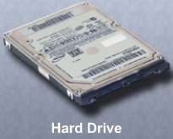
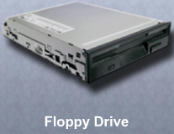
Hard Drives and Floppy Drives
Reads or writes information to magnetic or optical storage media
May be fixed or removable
The hard disk drive (HDD) is a
magnetic storage device installed
inside the computer. The storage
capacity is measured in gigabytes (GB).
A floppy disk drive (FDD) is storage device that uses removable 3.5 inch floppy disks that can store 1.44 MB of data.
Notes:
Slide 29 – Hard Drives and Floppy Drives
1.4.6 Identify the names, purposes, and characteristics of storage drives
A storage drive reads or writes information to magnetic or optical storage media. The drive can be used to store data permanently or to retrieve information from a media disk. Storage drives can be installed inside the computer case, such as a hard drive. For portability, some storage drives can connect to the computer using a USB port, a FireWire port, or an SCSI port. These portable storage drives are sometimes referred to as removable drives and can be used on multiple computers. Here are some common types of storage drives:
Floppy drive
Hard drive
Optical drive
Flash drive
Network drive
A floppy drive, or floppy disk drive, is a storage device that uses removable 3.5-inch floppy disks. These magnetic floppy disks can store 720 KB or 1.44 MB of data. In a computer, the floppy drive is usually configured as the A: drive. The floppy drive can be used to boot the computer if it contains a bootable floppy disk. A 5.25-inch floppy drive is older technology and is seldom used.
A hard drive, or hard disk drive, is a magnetic storage device that is installed inside the computer. The hard drive is used as permanent storage for data. In a computer, the hard drive is usually configured as the C: drive and contains the operating system and applications. The hard drive is usually configured as the first drive in the boot sequence. The storage capacity of a hard drive is measured in billions of bytes, or gigabytes (GB). The speed of a hard drive is measured in revolutions per minute (RPM). Multiple hard drives can be added to increase storage capacity.

Slide 30
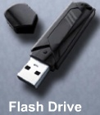
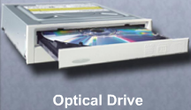
Optical Drives and Flash Drives
An optical drive is a storage device that uses lasers to read data on the optical media. The two types are CD and DVD.
A flash drive is a removable storage device that connects to a USB port. A flash drive uses a type
of memory that requires no power to maintain the
data.
Some common drive interfaces:
  Integrated Drive Electronics (IDE)
  Enhanced Integrated Drive Electronics (EIDE)
  Parallel ATA (PATA)
  Serial ATA (SATA)
  Small Computer System Interface (SCSI)
Notes:
Slide 30 – Optical Drives and Flash Drives
1.4.6 Identify the names, purposes, and characteristics of storage drives
An optical drive is a storage device that uses lasers to read data on the optical media. There are two types of optical drives:
Compact disc (CD)
Digital versatile disc (DVD)
CD and DVD media can be pre-recorded (read-only), recordable (write once), or re-recordable (read and write multiple times). CDs have a data storage capacity of approximately 700 MB. DVDs have a data storage capacity of approximately 8.5 GB on one side of the disc. There are several types of optical media:
CD-ROM – CD read-only memory media that is pre-recorded.
CD-R –CD-recordable media that can be recorded once.
CD-RW – CD-rewritable media that can be recorded, erased, and re-recorded.
DVD-ROM – DVD read-only memory media that is pre-recorded.
DVD-RAM – DVD-random access memory media that can be recorded, erased, and re-recorded.
DVD+/-R – DVD-recordable media that can be recorded once.
DVD+/-RW – DVD-rewritable media that can be recorded, erased, and re-recorded.
A flash drive, also known as a thumb drive, is a removable storage device that connects to a USB port. A flash drive uses a special type of memory that requires no power to maintain the data. These drives can be accessed by the operating system in the same way other types of drives are accessed.
Hard drives and optical drives are manufactured with different interfaces that are used to connect the drive to the computer. To install a storage drive in a computer, the connection interface on the drive must be the same as the controller on the motherboard. Here are some common drive interfaces:
IDE – Integrated Drive Electronics, also called Advanced Technology Attachment (ATA) is an early drive controller interface that connects computers and hard disk drives. An IDE interface uses a 40-pin connector.
EIDE – Enhanced Integrated Drive Electronics, also called ATA-2, is an updated version of the IDE drive controller interface. EIDE supports hard drives larger than 512 MB, enables Direct Memory Access (DMA) for speed, and uses the AT Attachment Packet Interface (ATAPI) to accommodate optical drives and tape drives on the EIDE bus. An EIDE interface uses a 40-pin connector.
PATA – Parallel ATA refers to the parallel version of the ATA drive controller interface.
SATA – Serial ATA refers to the serial version of the ATA drive controller interface. A SATA interface uses a 7-pin connector.
SCSI – Small Computer System Interface is a drive controller interface that can connect up to 15 drives. SCSI can connect both internal and external drives. An SCSI interface uses a 50-pin, 68-pin, or 80-pin connector.

Slide 31
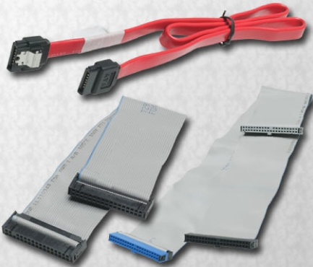
Internal Cables
Data cables connect drives to the drive controller, which is located on an adapter card or on the motherboard.
Floppy disk drive (FDD) data cable
PATA (IDE) data cable
PATA (EIDE) data cable
SATA data cable
SCSI data cable
Notes:
Slide 31 – Internal Cables
1.4.7 Identify the names, purposes, and characteristics of internal cables
Drives require both a power cable and a data cable. A power supply will have a SATA power connector for SATA drives, a Molex power connector for PATA drives, and a Berg 4-pin connector for floppy drives. The buttons and the LED lights on the front of the case connect to the motherboard with the front panel cables. Data cables connect drives to the drive controller, which is located on an adapter card or on the motherboard. Here are some common types of data cables:
Floppy disk drive (FDD) data cable – Data cable has up to two 34-pin drive connectors and one 34-pin connector for the drive controller.
PATA (IDE) data cable – Parallel ATA data cable has 40 conductors, up to two 40-pin connectors for drives, and one 40-pin connector for the drive controller.
PATA (EIDE) data cable – Parallel ATA data cable has 80 conductors, up to two 40-pin connectors for drives, and one 40-pin connector for the drive controller.
SATA data cable – Serial ATA data cable has seven conductors, one keyed connector for the drive, and one keyed connector the drive controller.
SCSI data cable – There are three types of SCSI data cables. A narrow SCSI data cable has 50-conductors, up to seven 50-pin connectors for drives, and one 50-pin connector for the drive controller, also called the host adapter. A wide SCSI data cable has 68-conductors, up to fifteen 68-pin connectors for drives, and one 68-pin connector for the host adapter. An Alt-4 SCSI data cable has 80-conductors, up to "15" 80-pin connectors for drives, and one 80-pin connector for the host adapter.
NOTE: A colored stripe on a cable identifies Pin 1 on the cable. When installing a data cable, always ensure that Pin 1 on the cable aligns with Pin 1 on the drive or drive controller. Some cables may be keyed and therefore they can only be connected one way to the drive and drive controller.
Student Activity: The student course content includes worksheet, 1.4.7 Research Computer Components. To complete this worksheet, students will research the components needed to complete a customer’s computer. They should be prepared to discuss their selections.

Slide 32
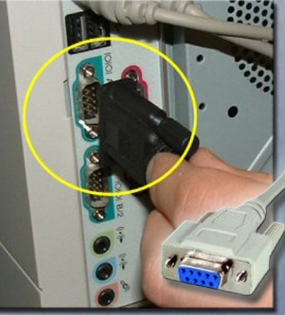
Serial Ports and Cables
A serial port can be either a DB-9, as shown, or a DB-25 male connector.
Serial ports transmit one bit of data at a time.
To connect a serial device, such as a modem or printer, a serial cable must be used.
A serial cable has a maximum length of 50 feet (15.2 m).
Notes:
Slide 32 – Serial Ports and Cables
1.5 Identify the names, purposes, and characteristics of ports and cables
Input/output (I/O) ports on a computer connect peripheral devices, such as printers, scanners, and portable drives. The following ports and cables are commonly used:
Serial
USB
FireWire
Parallel
SCSI
Network
PS/2
Audio
Video
Serial Ports and Cables - A serial port can be either a DB-9 or a DB-25 male connector. Serial ports transmit one bit of data at a time. To connect a serial device, such as a modem or printer, a serial cable must be used. A serial cable has a maximum length of 50 feet (15.2 m).

Slide 33
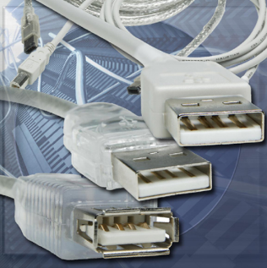
USB Ports and Cables
USB is a standard interface for
connecting peripheral devices to
a computer.
USB devices are hot-swappable.
USB ports are found on computers,
cameras, printers, scanners,
storage devices, and many other electronic devices.
A single USB port in a computer can support up to 127 separate devices with the use of multiple USB hubs.
Some devices can also be powered through the USB port, eliminating the need for an external power source.
Notes:
Slide 33 – USB Ports and Cables
1.5 Identify the names, purposes, and characteristics of ports and cables
USB Ports and Cables – The Universal Serial Bus (USB) is a standard interface that connects peripheral devices to a computer. It was originally designed to replace serial and parallel connections. USB devices are hot-swappable, which means that users can connect and disconnect the devices while the computer is powered on. USB connections can be found on computers, cameras, printers, scanners, storage devices, and many other electronic devices. A USB hub is used to connect multiple USB devices. A single USB port in a computer can support up to 127 separate devices with the use of multiple USB hubs. Some devices can also be powered through the USB port, eliminating the need for an external power source.
USB 1.1 allowed transmission rates of up to 12 Mbps in full-speed mode and 1.5 Mbps in low speed mode. USB 2.0 allows transmission speeds up to 480 Mbps. USB devices can only transfer data up to the maximum speed allowed by the specific port.

Slide 34
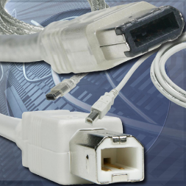
FireWire Ports and Cables
FireWire is a high-speed,
hot-swappable interface.
A single FireWire port in a computer
can support up to 63 devices.
Some devices can also be powered
through the FireWire port, eliminating the need for an external power source.
The IEEE 1394a standard supports data rates up to 400 Mbps and cable lengths up to 15 feet (4.5 m). This standard uses a 6-pin connector or a 4-pin connector.
The IEEE 1394b standard supports data rates in excess of 800 Mbps and uses a 9-pin connector.
Notes:
Slide 34 – FireWire Ports and Cables
1.5 Identify the names, purposes, and characteristics of ports and cables
FireWire Ports and Cables - FireWire is a high-speed, hot-swappable interface that connects peripheral devices to a computer. A single FireWire port in a computer can support up to 63 devices. Some devices can also be powered through the FireWire port, eliminating the need for an external power source. FireWire uses the IEEE 1394 standard and is also known as i.Link.
The IEEE 1394a standard supports data rates up to 400 Mbps and cable lengths up to 15 feet (4.5 m). This standard uses a 6-pin connector or a 4-pin connector. The IEEE 1394b standard supports data rates in excess of 800 Mbps and uses a 9-pin connector.

Slide 35
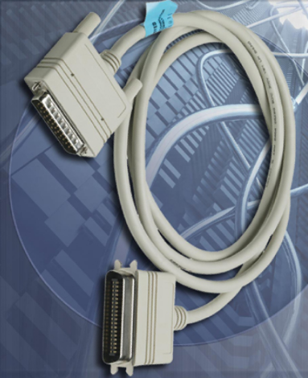
Parallel Ports and Cables
Parallel ports can transmit 8 bits of data at one time and use the IEEE 1284 standard.
To connect a parallel device, such as a printer, a parallel cable must be used.
A parallel cable has a maximum length of 15 feet (4.5 m).
Notes:
Slide 35 – Parallel Ports and Cables
1.5 Identify the names, purposes, and characteristics of ports and cables
Parallel Ports and Cables – A parallel port on a computer is a standard Type A DB-25 female connector. The parallel connector on a printer is a standard Type B 36-pin Centronics connector. Some newer printers may use a Type C high-density 36-pin connector. Parallel ports can transmit 8 bits of data at one time and use the IEEE 1284 standard. To connect a parallel device, such as a printer, a parallel cable must be used. A parallel cable has a maximum length of 15 feet (4.5 m).

Slide 36



SCSI Ports and Cables
A SCSI port can transmit data at rates in
excess of 320 Mbps and can support up
to 15 devices.
Three different types of SCSI ports:
  DB-25 female connector
  High-density 50-pin female connector
  High-density 68-pin female connector
NOTE: SCSI devices must be terminated at the endpoints of the SCSI chain. Check the device manual for termination procedures.
CAUTION: Some SCSI connectors resemble parallel connectors. The voltage used in the SCSI format may damage the parallel interface.
Notes:
Slide 36 – SCSI Ports and Cables
1.5 Identify the names, purposes, and characteristics of ports and cables
SCSI Ports and Cables – A SCSI port can transmit data at rates in excess of 320 Mbps and can support up to 15 devices. If a single SCSI device is connected to an SCSI port, the cable can be up to 80 feet (24.4 m) in length. If multiple SCSI devices are connected to an SCSI port, the cable can be up to 40 (12.2 m) feet in length. An SCSI port on a computer can be one of three different types:
DB-25 female connector
High-density 50-pin female connector
High-density 68-pin female connector
NOTE: SCSI devices must be terminated at the endpoints of the SCSI chain. Check the device manual for termination procedures.
CAUTION: Some SCSI connectors resemble parallel connectors. Be careful not to connect the cable to the wrong port. The voltage used in the SCSI format may damage the parallel interface. SCSI connectors should be clearly labeled.

Slide 37
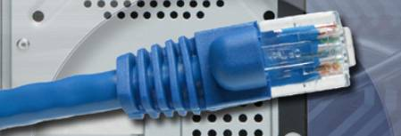
Network Ports and Cables
A network port, also known as an RJ-45 port, connects a computer to a network.
Standard Ethernet can transmit up to 10 Mbps.
Fast Ethernet can transmit up to 100 Mbps.
Gigabit Ethernet can transmit up to 1000 Mbps.
The maximum length of network cable is 328 feet (100 m).
Notes:
Slide 37 – Network Ports and Cables
1.5 Identify the names, purposes, and characteristics of ports and cables
Network Ports and Cables – A network port, also known as an RJ-45 port, connects a computer to a network. The connection speed depends on the type of network port. Standard Ethernet can transmit up to 10 Mbps, Fast Ethernet can transmit up to 100 Mbps, and Gigabit Ethernet can transmit up to 1000 Mbps. The maximum length of network cable is 328 feet (100 m).

Slide 38
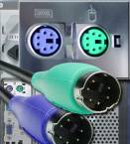
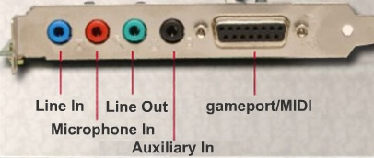
PS/2 Ports and Audio Ports
A PS/2 port connects a keyboard or a mouse to a computer.
The PS/2 port is a 6-pin mini-DIN female connector.
Line In connects to an external source
Microphone In connects to a microphone
Line Out connects to speakers or headphones
Gameport/MIDI connects
to a joystick or
MIDI-interfaced device
Notes:
Slide 38 – PS/2 Ports and Audio Ports
1.5 Identify the names, purposes, and characteristics of ports and cables
PS/2 Ports - A PS/2 port connects a keyboard or a mouse to a computer. The PS/2 port is a 6-pin mini-DIN female connector. The connectors for the keyboard and mouse are often colored differently. If the ports are not color-coded, look for a small figure of a mouse or keyboard next to each port.
Audio Ports - An audio port connects audio devices to the computer. The following audio ports are commonly used:
Line In – Connects to an external source, such as a stereo system
Microphone – Connects to a microphone
Line Out – Connects to speakers or headphones
Gameport/MIDI – Connects to a joystick or MIDI-interfaced device

Slide 39
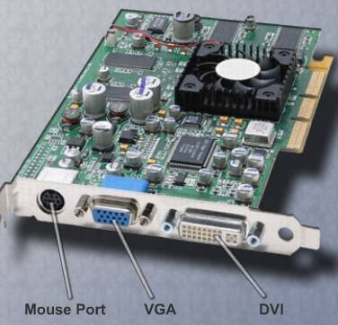
Video Ports
A video port connects a monitor cable to a computer.
Video Graphics Array (VGA)
Digital Visual Interface (DVI)
High-Definition Multimedia Interface (HDMi)
S-Video
Component/RGB
Notes:
Slide 39 – Video Ports
1.5 Identify the names, purposes, and characteristics of ports and cables
Video Ports and Connectors - A video port connects a monitor cable to a computer. There are several video port and connector types:
Video Graphics Array (VGA) – VGA has a 3-row 15-pin female connector and provides analog output to a monitor.
Digital Visual Interface (DVI) – DVI has a 24-pin female connector or a 29-pin female connector and provides a compressed digital output to a monitor. DVI-I provides both analog and digital signals. DVI-D provides digital signals only.
High-Definition Multimedia Interface (HDMi) – HDMi has a 19-pin connector and provides digital video and digital audio signals.
S-Video – S-Video has a 4-pin connector and provides analog video signals.
Component/RGB – RGB has three shielded cables (red, green, blue) with RCA jacks and provides analog video signals.

Slide 40
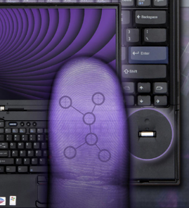
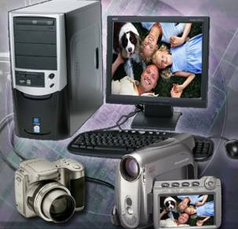
Input Devices
Fingerprint scanner
Input devices used to enter data or
instructions into a computer:
Mouse and Keyboard
Digital camera and digital video
camera
Biometric authentication device
Touch screen
Scanner
Digital camera
Notes:
Slide 40 – Input Devices
1.6 Identify the names, purposes, and characteristics of input devices
Here are some examples of input devices used to enter data or instructions into a computer:
The mouse and keyboard are the two most commonly used input devices. The mouse is used to navigate the graphical user interface (GUI). The keyboard is used to enter text commands that control the computer.
Digital cameras and digital video cameras create images that can be stored on magnetic media. The image is stored as a file that can be displayed, printed, or altered.
Biometric identification makes use of features that are unique to an individual user, such as fingerprints, voice recognition, or a retinal scan. When combined with ordinary usernames, biometrics guarantees that the authorized person is accessing the data.
A touch screen has a pressure-sensitive transparent panel. The computer receives instructions specific to the place on the screen that the user touches.
A scanner digitizes an image or document. The digitization of the image is stored as a file that can be displayed, printed, or altered. A bar code reader is a type of scanner that reads universal product code (UPC) bar codes. It is widely used for pricing and inventory information.

Slide 41
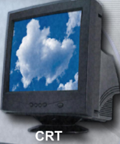
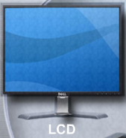
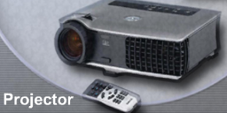
Monitors and Projectors
The most important difference between these monitor types is the technology used to create an image:
Cathode-ray tube (CRT) monitor is the most common monitor type. Most televisions also use this technology.
Liquid crystal display (LCD) is commonly used in laptops and some projectors. LCD comes in two forms, active matrix and passive matrix.
Digital light processing (DLP) is another technology used in projectors.
Notes:
Slide 41 – Monitors and Projectors
1.7 Identify the names, purposes, and characteristics of output devices
An output device is used to present information to the user from a computer. Here are some examples of output devices:
Monitors and projectors
Printers, scanners, and fax machines
Speakers and headphones
Monitors and Projectors - Monitors and projectors are primary output devices for a computer. The most important difference between these monitor types is the technology used to create an image:
CRT – Cathode-ray tube monitor is the most common monitor type. Red, green, and blue electron beams move back and forth across the phosphorous-coated screen. The phosphor glows when struck by the electron beam. Areas not struck by the electron beam do not glow. The combination of glowing and non-glowing areas is what creates the image on the screen. Most televisions also use this technology.
LCD – Liquid crystal display is commonly used in laptops and some projectors. It consists of two polarizing filters with a liquid crystal solution between them. An electronic current aligns the crystals so that light can either pass through or not pass through. The effect of light passing through in certain areas and not in others is what creates the image. LCD comes in two forms, active matrix and passive matrix. Active matrix is sometimes called thin film transistor (TFT). TFT allows each pixel to be controlled, which creates very sharp color images. Passive matrix is less expensive than active matrix but does not provide the same level of image control.
DLP – Digital light processing is another technology used in projectors. DLP projectors use a spinning color wheel with a microprocessor-controlled array of mirrors called a digital micromirror device (DMD). Each mirror corresponds to a specific pixel. Each mirror reflects light toward or away from the projector optics. This creates a monochromatic image of up to 1024 shades of gray in between white and black. The color wheel then adds the color data to complete the projected, color image.
Monitor resolution refers to the level of image detail that can be reproduced. Higher resolution settings produce better image quality. There are several factors involved in monitor resolution:
Pixels – The term pixel is an abbreviation for picture element. Pixels are the tiny dots that comprise a screen. Each pixel consists of red, green, and blue.
Dot Pitch – Dot pitch is the distance between pixels on the screen. A lower dot pitch number produces a better image.
Refresh Rate – The refresh rate is how often per second the image is rebuilt. A higher refresh rate produces a better image and reduces the level of flicker.
Interlace/Non-Interlace – Interlaced monitors create the image by scanning the screen two times. The first scan covers the odd lines, top to bottom, and the second scan covers the even lines. Non-interlaced monitors create the image by scanning the screen, one line at a time from top to bottom. Most CRT monitors today are non-interlaced.
Horizontal Vertical Colors (HVC) – The number of pixels in a line is the horizontal resolution. The number of lines in a screen is the vertical resolution. The number of colors that can be reproduced is the color resolution.
Aspect Ratio – Aspect ratio is the horizontal to vertical measurement of the viewing area of a monitor. For example, a 4:3 aspect ratio would apply to a viewing area that is 16 inches wide by 12 inches high. A 4:3 aspect radio would also apply to a viewing area that is 24 inches wide by 18 inches high. A viewing area that is 22 inches wide by 12 inches high has an aspect ratio of 11:6.
Monitors have controls for adjusting the quality of the image. Here are some common monitor settings:
Brightness – Intensity of the image
Contrast – Ratio of light to dark
Position – Vertical and horizontal location of image on the screen
Reset – Returns the monitor settings to factory settings

Slide 42
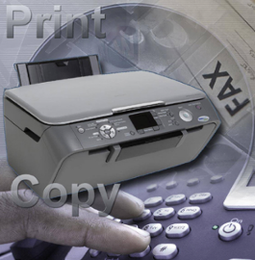
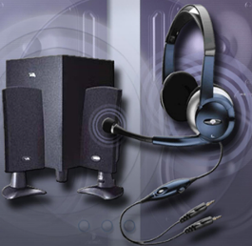
Other Output Devices
Printers, Scanners, and Fax Machines - Printers are output devices that create hard copies of computer files. Other all-in-one type printers are designed to provide multiple services such as printing, fax, and copier functions.
Speakers and headphones are output devices for audio signals.
  Most computers have audio support either integrated into the motherboard or on an adapter card.
  Audio support includes ports that allow input and output of audio signals.
Headphones
Speakers
Notes:
Slide 42 – Other Output Devices
1.7 Identify the names, purposes, and characteristics of output devices
Printers, Scanners, and Fax Machines - Printers are output devices that create hard copies of computer files. Some printers specialize in particular applications, such as printing color photographs. Other all-in-one type printers are designed to provide multiple services such as printing, fax, and copier functions.
Speakers and Headphones - Speakers and headphones are output devices for audio signals. Most computers have audio support either integrated into the motherboard or on an adapter card. Audio support includes ports that allow input and output of audio signals. The audio card has an amplifier to power headphones and external speakers.

Slide 43

Q and A
Notes:
Slide 52 – Q and A

